Slide 1
Memory-safety Programming 内存安全程序设计

Slide 2
Content
Background
Memory-safety problems
Temporal memory problems：smart pointer
Spatial memory problems：dynamic bound checking

Slide 3
Taxonomy
时间类内存安全（Temporal safety caused by lifetime violation）
释放后使用（Use after free）
重复释放（Double free）
悬垂指针（Dangling pointer）
内存泄漏（Memory leak）
…
空间类内存安全（Spatial safety caused by wrong access）
缓冲区溢出（Buffer overflow）
解引用空指针（Null pointer dereferencing）
访问未初始化内存（Dereference uninitialized pointer）
…

Slide 4
Temporal Memory Problems
char* ptr = (char*) malloc(SIZE);
if (err) {
abrt = 1;
free(ptr);
}
if (abrt) {
logError("operation aborted before commit", ptr);
}
Use-After-Free
CWE-416: Use After Free https://cwe.mitre.org/data/definitions/416.html

Slide 5
Temporal Memory Problems
char* getBlock(int fd) {
char* buf = (char*) malloc(BLOCK_SIZE);
if (!buf) {
return NULL;
}
if (read(fd, buf, BLOCK_SIZE) != BLOCK_SIZE) {
return NULL;
}
return buf;
}
Memory Leak
CWE-401: Memory Leak https://cwe.mitre.org/data/definitions/401.html
Notes:
The following C function leaks a block of allocated memory if the call to read() does not return the expected number of bytes.

Slide 6
Temporal Memory Problems
int* fun()
{
// x is local variable and goes out of
scope after fun() is returned
int x = 5;
return &x;
}
int main()
{
int* p = fun();
// p points to something which
is not valid anymore
printf("%d", *p);
return 0;
}
int main()
{
int* ptr;
// creating an inner block
{
int a = 10;
ptr = &a;
}
// ptr here becomes dangling pointer
printf("%d", *ptr);
return 0;
}
Dangling Pointer
https://www.geeksforgeeks.org/dangling-void-null-wild-pointers/

Slide 7
Temporal Memory Safety
时间类内存安全（Temporal safety caused by lifetime violation）
释放后使用（Use after free）
重复释放（Double free）
悬垂指针（Dangling pointer）
内存泄漏（Memory leak）
…
如何从程序设计的角度避免
时间类内存安全问题？

Slide 8
RAII
void printFile(const char* name) {
// acquire file resource
FILE* f = fopen(name, "r");
// print contents of f
…
// release file resource
fclose(f);
}
File I/O

Slide 9
RAII
void printFile(const char* name) {
// acquire file resource
FILE* f = fopen(name, "r");
// print contents of f
…
// release file resource
fclose(f);
}
what if this is missed?
File I/O

Slide 10
RAII
Resource Acquisition Is Initialisation
When you initialize an object, it should already have acquired any resources it needs (in the constructor).
When an object goes out of scope, it should release every resource it is using (using the destructor).

Slide 11


RAII
Resource Acquisition Is Initialisation
When you initialize an object, it should already have acquired any resources it needs (in the constructor).
When an object goes out of scope, it should release every resource it is using (using the destructor).
Constructor Acquires, Destructor Releases

Slide 12
RAII
class FileObj {
public:
FILE* ptr;
FileObj(char* name) {
ptr = fopen(name, "r");
}
~FileObj() {
fclose(ptr);
}
};
void printFile(const char* name) {
// initialization will acquire resources
FileObj fobj(name);
// print contents of f
…
// FileObj destructor will release resources
}
https://web.stanford.edu/class/archive/cs/cs106l/cs106l.1192/lectures/lecture15/15_RAII.pdf

Slide 13
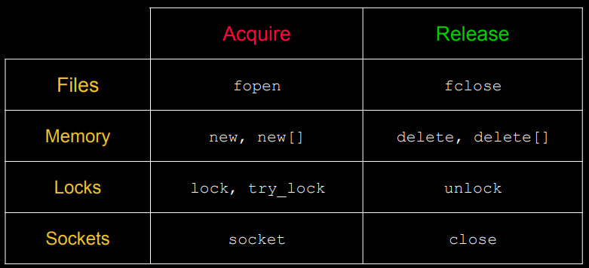
Other Resources
Can be RAII applied to heap memory management？
https://web.stanford.edu/class/archive/cs/cs106l/cs106l.1192/lectures/lecture15/15_RAII.pdf

Slide 14
C++ Smart Pointers
What?
A smart pointer is an object that stores a pointer to a heap-allocated object
Why?
With correct use of smart pointers, you no longer have to explicitly call delete() to free heap memory.
How?
A smart pointer are implemented via class template while overloading *, ->, [], etc.

Slide 15
Toy_ptr
template <typename T> class ToyPtr {
public:
explicit ToyPtr(T *ptr):ptr_(ptr){} //constructor
~ToyPtr() { delete ptr_; } //destructor
T & operator*() { return *ptr_; } // * operator
T * operator->() { return ptr_; } // -> operator
private:
T *ptr_; // the pointer
};
int main() {
//heap is automatically freed when main() is finished
ToyPtr<int> int_sp(new int(8));
}

Slide 16
Toy_ptr
Cannot handle:
Arrays
Copying
Assignment
Move semantics
…
STL provides non-toy smart pointers
std::unique_ptr
std::shared_ptr
std::weak_ptr

Slide 17
std::unique_ptr
A unique_ptr takes ownership of a pointer
Exclusive ownership
Lightweight pointer
Destroys the object when goes out of scope by invoking delete() in destructor
#include <memory> // for std::unique_ptr
int main() {
// unique_ptr points to heap variable; never used delete, but no leak
std::unique_ptr<int> x(new int(5));
(*x)--;
return 0;
}

Slide 18
std::unique_ptr
If you have many potential exits out of a function, it’s easy to forget to call delete() on all of them
unique_ptr will delete its pointer when it falls out of scope
A unique_ptr also helps with exception safety
#include <memory> // for std::unique_ptr
int main() {
std::unique_ptr<int> x(new int(5));
…
// lots of code, including several returns
// lots of code, including potential exception throws
}

Slide 19
std::unique_ptr
Initialization
Constructor
T *pT = new T();
std::unique_ptr<T> p1 (pT);
std::unique_ptr<T> p2 (new T());
Make_unique
std::unique_ptr<T> p3 = make_unique<T>();
Move
std::unique_ptr<T> p4 = std::move(p1);

Slide 20
std::unique_ptr
unique_ptr cannot be copied to maintain uniqueness or ownership
Its copy constructor and assignment operator are disabled
#include <memory> // for std::unique_ptr
int main() {
std::unique_ptr<int> x(new int(5)); // line 1
std::unique_ptr<int> y(x); // line 2
std::unique_ptr<int> z; // line 3
z = x; // line 4
return 0;
}

Slide 21

std::unique_ptr
unique_ptr cannot be copied to maintain uniqueness or ownership
Its copy constructor and assignment operator are disabled
#include <memory> // for std::unique_ptr
int main() {
std::unique_ptr<int> x(new int(5)); // line 1
std::unique_ptr<int> y(x); // line 2
std::unique_ptr<int> z; // line 3
z = x; // line 4
return 0;
}

Slide 22
std::unique_ptr
unique_ptr use reset() and release() to transfer ownership
release() returns the wrapped raw pointer, and sets itself to nullptr
#include <memory> // for std::unique_ptr
int main() {
std::unique_ptr<int> x(new int(5));
int* raw_ptr = x.release(); // release the ownership
if(x == nullptr){ // x is null now
std::cout << “x is now empty” << std::endl;
}
delete raw_ptr;
return 0;
}

Slide 23
std::unique_ptr
unique_ptr use reset() and release() to transfer ownership
release() returns the wrapped raw pointer, and sets itself to nullptr
reset() delete’s the current pointer and stores a new one
#include <memory> // for std::unique_ptr
int main() {
std::unique_ptr<int> x(new int(5));
std::unique_ptr<int> z(new int(8));
// x transfers ownership of its pointer to z; z’s old pointer was deleted.
z.reset(x.release());
return 0;
}

Slide 24
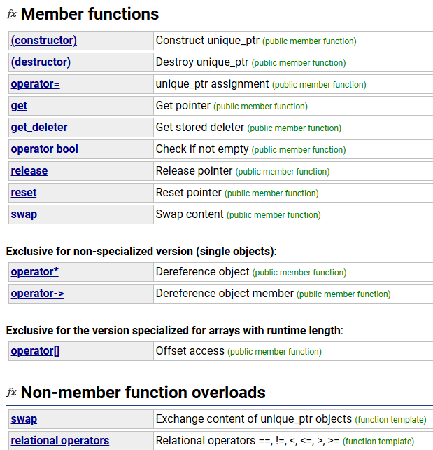
std::unique_ptr
https://cplusplus.com/reference/memory/unique_ptr/

Slide 25
std::unique_ptr
“Move semantics” move values from one object to another without copying
Std::string returnString(){
std::string x("foo");
return x;
}
int main() {
std::string a("hello");
std::string b = std::move(a); // move a to b
b = std::move(returnString()); // move the returned value into b
return 0;
}

Slide 26
std::unique_ptr
unique_ptr supports move semantics
Can “move” ownership from one unique_ptr to another
Equivalent to “release-and-reset”
#include <memory> // for std::unique_ptr
int main() {
std::unique_ptr<int> x(new int(5));
std::unique_ptr<int> y = std::move(x); // y gets the ownership from x
std::unique_ptr<int> z(new int(8));
// y transfers ownership of its pointer to z; z’s old pointer was deleted.
z = std::move(y);
return 0;
}

Slide 27
std::shared_ptr
Is unique_ptr enough? NO!
In some scenarios, multiple pointers of the same object are needed, e.g., multithreaded programming
void inc(std::unique_ptr<int> x){
(*x)++;
std::count << *x << std::endl;
}
int main() {
std::unique_ptr<int> m(new int(5));
std::thread t1(inc, m);
std::thread t2(inc, m);
t1.join(); t2.join();
return 0;
}

Slide 28
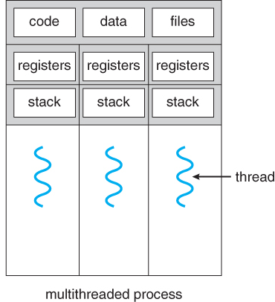
std::shared_ptr
Is unique_ptr enough? NO!
In some scenarios, multiple pointers of the same object are needed, e.g., multithreaded programming
void inc(std::unique_ptr<int> x){
(*x)++;
std::count << *x << std::endl;
}
int main() {
std::unique_ptr<int> m(new int(5));
std::thread t1(inc, m);
std::thread t2(inc, m);
t1.join(); t2.join();
return 0;
}

Slide 29
std::shared_ptr
shared_ptr is similar to unique_ptr, but allow shared objects to have multiple owners
Shared ownership
Destroys the object when last reference is released
shared_ptr is implemented via reference counting
Associate a reference counter with each object

Slide 30
std::shared_ptr
Idea: associate a reference counter with each object
Constructors create a counter holding number of references (pointers) to the object
Adjusted whenever pointers are changed:
Copy constructor and operator = will increment the counter by 1
Destructor will decrement the counter by 1
When reference counter decreased to 0, no more pointers to the object, so delete it (automatically)

Slide 31
std::shared_ptr
#include <iostream>
#include <memory> // for std::shared_ptr
int main(int argc, char **argv) {
std::shared_ptr<int> x(new int(10)); // ref count for “10” node: 1
std::shared_ptr<int> y = x; // ref count for “10” node: 2
auto z(y); // ref count for “10” node: 3
auto w = make_shared<int>(100); // ref count for “100” node: 1
return 0;
} // ref count: 0

Slide 32
std::shared_ptr
#include <iostream>
#include <memory> // for std::shared_ptr
int main(int argc, char **argv) {
std::shared_ptr<int> x(new int(10)); // ref count: 1
// temporary inner scope with local y
{
std::shared_ptr<int> y = x; // ref count: 2
std::cout << *y << std::endl;
auto z(y); // ref count: 3
} // exit scope, y and z deleted
std::cout << *x << std::endl; // ref count: 1
return 0;
} // ref count: 0

Slide 33
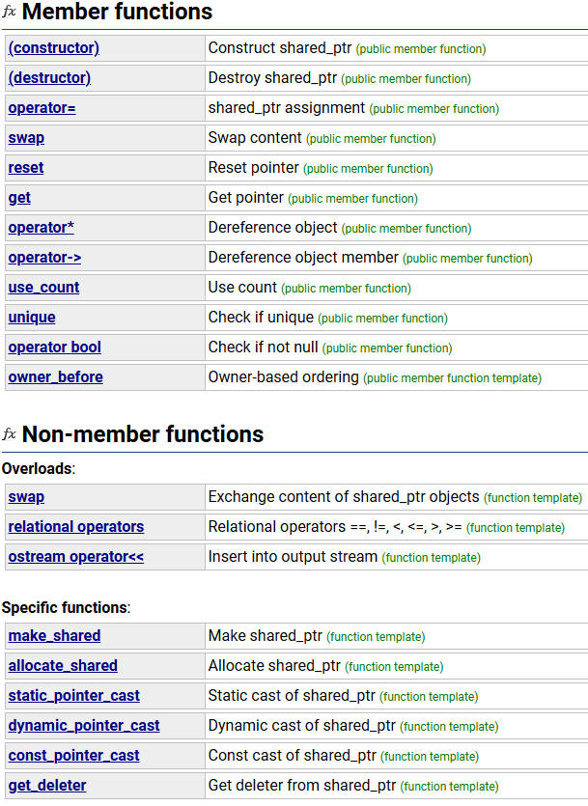
std::shared_ptr
https://cplusplus.com/reference/memory/shared_ptr/

Slide 34
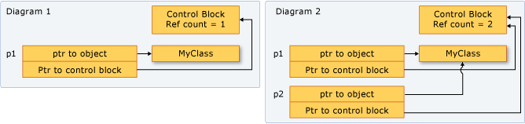
std::shared_ptr
https://learn.microsoft.com/en-us/cpp/cpp/how-to-create-and-use-shared-ptr-instances?view=msvc-170

Slide 35
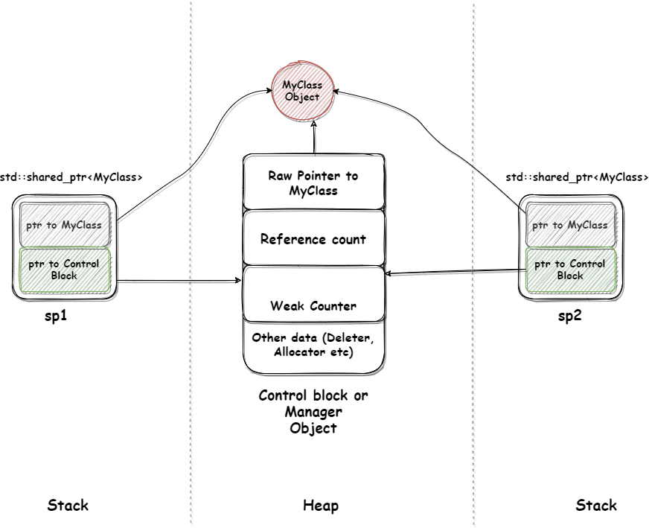
std::shared_ptr
https://learn.microsoft.com/en-us/cpp/cpp/how-to-create-and-use-shared-ptr-instances?view=msvc-170
https://dev.to/pratikparvati/memory-management-using-smart-pointers-in-c-part-2-3pp4

Slide 36
std::shared_ptr
Avoid the duplicated creation of shared_ptrs to the same object
#include <memory>
int main() {
int * p = new int(5);
std::shared_ptr<int> x(p); // x maintains a ref count: 1
// temporary inner scope with local y
{
std::shared_ptr<int> y(p); // y maintains another ref count: 1
} // exit scope, y deleted, p deleted as well
std::cout << *x << std::endl; // dangling pointer, use-after-free
return 0; // double delete
}

Slide 37
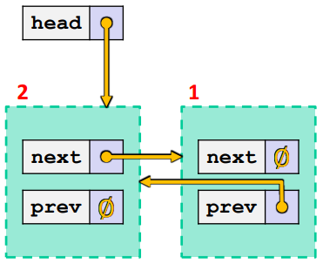
std::shared_ptr
shared_ptrs are deleted when their reference count drops to 0. It doesn’t work well for some scenarios: cyclic reference of shared_ptrs
#include <memory> // for std::unique_ptr
struct A {
std::shared_ptr<A> next;
std::shared_ptr<A> prev;
};
int main() {
A* raw_a = new A();
A* raw_b = new A();
std::shared_ptr<A> head(raw_a);
head->next = std::shared_ptr<A>(raw_b);
head->next->prev = head;
return 0;
}
raw_a
raw_b
What happens when we delete head?

Slide 38
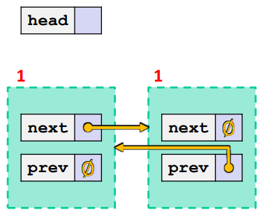
std::shared_ptr
shared_ptrs are deleted when their reference count drops to 0. It doesn’t work well for some scenarios: cyclic reference of shared_ptrs
#include <memory> // for std::unique_ptr
struct A {
std::shared_ptr<A> next;
std::shared_ptr<A> prev;
};
int main() {
A* raw_a = new A();
A* raw_b = new A();
std::shared_ptr<A> head(raw_a);
head->next = std::shared_ptr<A>(raw_b);
head->next->prev = head;
return 0;
}
What happens when we delete head? Unreachable nodes aren’t deleted because ref counts > 0

Slide 39
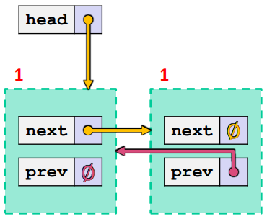
std::weak_ptr
weak_ptr is similar to a shared_ptr but doesn’t affect the reference count; it can be used to break the cycle reference problem.
#include <memory> // for std::unique_ptr
struct A {
std::shared_ptr<A> next;
std::weak_ptr<A> prev;
};
int main() {
A* raw_a = new A();
A* raw_b = new A();
std::shared_ptr<A> head(raw_a);
head->next = std::shared_ptr<A>(raw_b);
head->next->prev = head;
return 0;
}
What happens when we delete head?

Slide 40
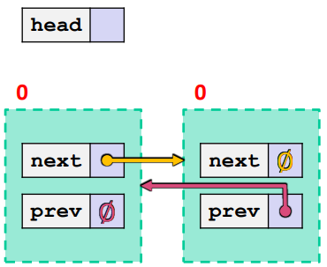
std::weak_ptr
weak_ptr is similar to a shared_ptr but doesn’t affect the reference count; it can be used to break the cycle reference problem.
#include <memory> // for std::unique_ptr
struct A {
std::shared_ptr<A> next;
std::weak_ptr<A> prev;
};
int main() {
A* raw_a = new A();
A* raw_b = new A();
std::shared_ptr<A> head(raw_a);
head->next = std::shared_ptr<A>(raw_b);
head->next->prev = head;
return 0;
}
What happens when we delete head? Ref counts go to 0 and nodes deleted!

Slide 41
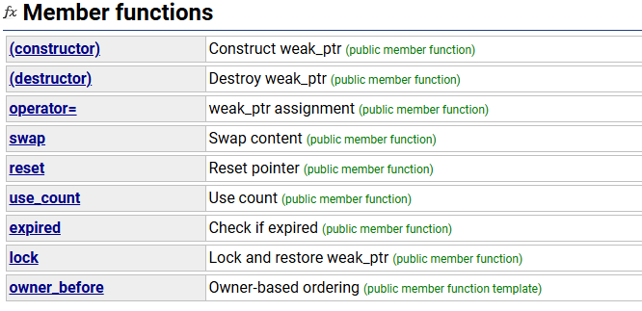
std::weak_ptr
use_count(): gets reference count
expired(): returns (use_count() == 0)
lock(): returns an "upgraded" weak_ptr to a shared_ptr
Basically implemented as expired()?shared_ptr<T>(nullptr):shared_ptr<T>(this)
https://cplusplus.com/reference/memory/weak_ptr/

Slide 42
std::weak_ptr
#include <iostream>
#include <memory> // for std::shared_ptr
int main(int argc, char **argv) {
std::weak_ptr<int> w;
{
std::shared_ptr<int> x;
{
std::shared_ptr<int> y(new int(10));
w = y; // weak ref; ref count for “10” node is same
x = w.lock(); // get "promoted" shared_ptr, ref cnt = 2
std::cout << *x << std::endl;
} // y deleted; ref count now 1
std::cout << *x << std::endl;
} // x deleted; ref count now 0; mem freed
std::shared_ptr<int> a = w.lock(); // nullptr
std::cout << a << std::endl; // output is 0 (null)
return 0;
}

Slide 43
References
Memory management using Smart Pointers in C++
https://dev.to/pratikparvati/memory-management-using-smart-pointers-in-c-part-1-4j2k
https://dev.to/pratikparvati/memory-management-using-smart-pointers-in-c-part-2-3pp4
University of Washington CSE333: Systems Programming
https://courses.cs.washington.edu/courses/cse333/24sp/lectures/16-c++-smartptr.pdf
Stanford University CS106L Standard C++ Programming
https://web.stanford.edu/class/archive/cs/cs106l/cs106l.1192/lectures/lecture15/15_RAII.pdf

